Slide 1
Optical Networks [EENGM0003]
Dr. George T. Kanellos
[gt.kanellos@bristol.ac.uk]

Slide 2
Client layers of the optical layer

Slide 3
WDM Optical Transport Networking
What is WDM Optical Networking?
Transport Networking at a new level of granularity--the Optical Channel (OCh) Level: OCh-level routing and switching (i.e., beyond simple pt-to-pt WDM systems)
Managing optical frequency-slots (OCh’s)
To create a new transport layer (the Optical Transport Network) requires building transport layer functionality into the Optical Layer
To Network Optical Channels requires an ability to manage Optical Channels
OCh-level OAM (Operations, Administration, Maintenance) information will be needed to support Optical Networking applications

Slide 4
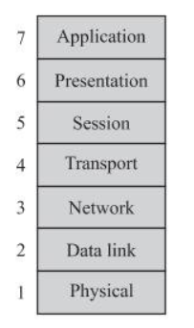
OSI model
In-sequence, error free messages
TCP
End-to-end routing
IP
Ethernet
Framing/MUX/DEMUX/MAC
PPP
A pipe that provides “bandwidth”to the data link

Slide 5
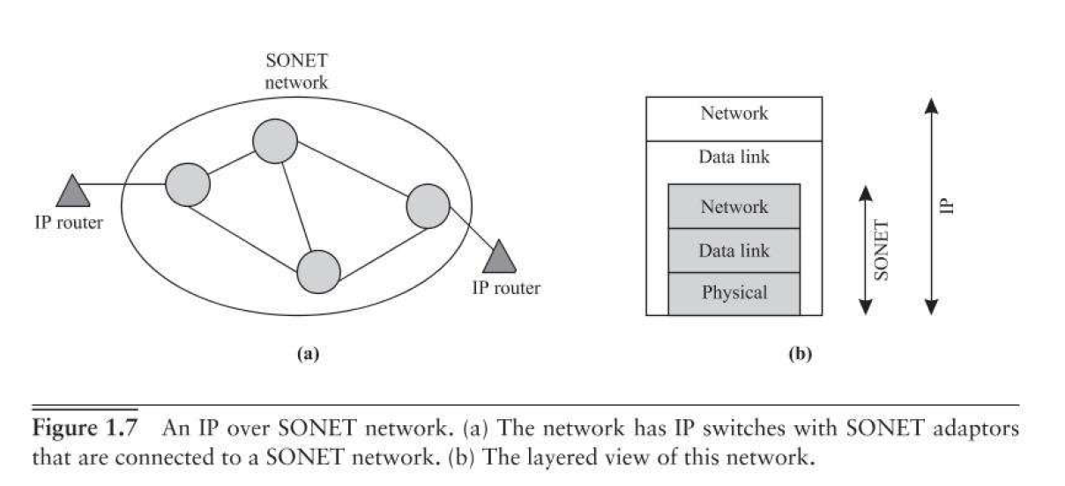
IP over SONET

Slide 6
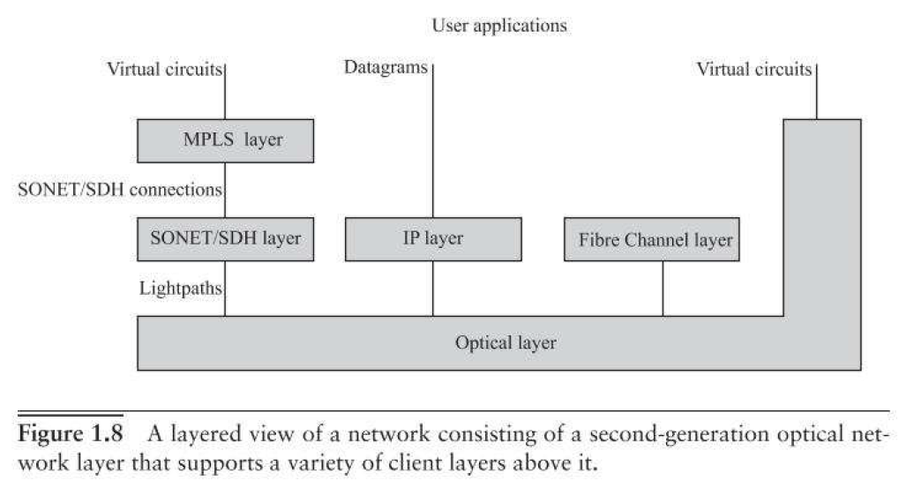
The optical layer
Client layers
Second gen. optical networks → optical layer provides lightpath services

Slide 7
Client layers to be discussed
SONET/SDH
- - 1st gen backbone optical networks (for low speed voice -51Mb/s)
Provides managed, end-to-end circuit switched connections
Efficient Time-division multiplexing
Supports data network and packet traffic
Optical Transport Network
Builds on SONET/SDH principles
Carries all types of data traffic
Very high transmission rates
Complete set of operation/management features

Slide 8
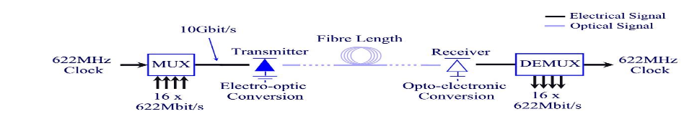
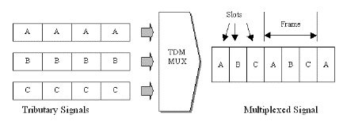
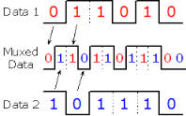
Multiplexing in optical communication [Optical-ETDM]
Number of lower speed (baseband) sub-channels multiplexed in time domain using electronics forming aggregate (total) signal
This electrically multiplexed signal then converted into optical form in the transmitter
Bellcore came up with Synchronous Optical Network (SONET) while ITU in Europe came up with Synchronous Digital Hierarchy (SDH)
SDH based on 155.52Mbit/s
SONET based on 51.84Mbit/s

Slide 9
The SONET/SDH Hierarchy
Electrical side of a SONET signal is a Synchronous Transport Signal (STS)
Electrical side of a SDH signal is a Synchronous Transport Module (STM)
Optical side of a SDH/SONET signal is an Optical Carrier (OC)
Optical SONET SDH Data rate Overhead rate Payload rate
level level level (Mbps) (Mbps) (Mbps) (electrical) (electrical)
OC-1 STS-1 ---- 51.84 1.728 50.112 OC-3 STS-3 STM-1 155.52 5.184 150.336 OC-12 STS-12 STM-4 622.08 20.736 601.344
OC-48 STS-48 STM-16 2488.32 82.944 2405.376
OC-192 STS-192 STM-64 9953.28 331.776 9621.504
OC-768 STS-768 STM-256 39,814.32 1327.104 38486.016
SDH basic rate (higher than SONET) – chosen to accommodate the commonly used PDH signals

Slide 10
SDH Frame Structure
The STM-1 frame is the basic transmission format for SDH. The frame lasts for 125µs (= 1/8kHz sampling rate). Therefore, there are 8000 frames per second.
The STM-1 consists of overhead plus a virtual container capacity.
First nine columns of each frame make up the section overhead and the last 261 columns make up the Virtual Container capacity. The VC plus the pointers (H1, H2, H3) is called the Administrative Unit (AU).
The STM frame is transmitted in a byte-serial fashion, row-by-row.

Slide 11
Frame Structure Synchronous Transport Module (STM-1)
125µs
Byte-wise Representation
Transport overhead (3%)
Usual Representation
9 rows
9 columns
64kbit/s
270 columns
Repetitive frame structure with a periodicity of 125µs, the same as that of primary rate (E1)
9 x 270 = 2430 bytes in 125µs ie 2430 x 8 * 8000 = 155.52Mbit/s aggregate bit-rate
9 x 261 = 2349 bytes in 125µs ie 2349 x 8 * 8000 = 150.336bit/s useful payload per frame

Slide 12
SDH/SONET Network Elements
Add/drop multiplexer (ADM)
Drops entire multiplexes
Terminal multiplexer (TM)
Multiplexes traffic to different multiplexing hierarchies
Digital cross-connect (DXC)
Switches virtual containers (VCs) between ports
Regenerator
Deployed when distance > 40-60km in order to “clean-up” the signal
NxN

Slide 13
Typical SDH/SONET Network
ADM
Ring A
ATM Switch
ADM
ADM
DXC interconnects rings
Ring B
IP Router
ADM
ADM
Trunk Interfaces
ADM
Tributary Interfaces
TM
Point to point segment
Regenerator
TM
IP Router
ATM Switch

Slide 14
SDH/SONET Layers Terminology
The SDH layer consists of three sub-layers: the path, line and section
The SDH framing structure defines overheads operating at these layers (except photonic layer) to estimate error rates, communicate alarm conditions and provide maintenance support.
These overhead bytes are added whenever the layer is introduced and removed (when the layer is terminated in a network element).
Path
Line
line
Section
Section
TM
ADM
ADM
PTE
ADM
TM
PTE
PTE
PTE
Regenerator
Regenerator
Remember that these SDH layers are within layer 1 (physical layer) of the OSI model

Slide 15
SDH/SONET Layers Terminology
The Path Layer is responsible for end-to-end connections between nodes and is terminated ONLY at the ends of an SDH connection.
The Line layer multiplexes a number of path-layer connections onto a single link between two nodes. Terminated at each intermediate terminal multiplexer (TM) or add/drop multiplexer (ADM).
The Section layer are the links between regenerators and the regenerator section is terminated at each regenerator in the network.
The Photonic Layer is responsible for transmission of bits across the fibre.
Path
Path
M S
M S
M S
M S
Regen S
Regen S
Regen S
Regen S
Regen S
Photonic
Photonic
Photonic
Photonic
Photonic
ATM Switch/ IP Router
SDH Digital Cross- Connect (DXC)
SDH Digital Cross- Connect (DXC)
ATM Switch/ IP Router
Regenerator

Slide 16
Building SDH Core Networks Increasing capacity in “fibre-rich” networks
Increase capacity by “stacking” SDH Rings (Space Division Multiplexing)
ADM
STM-x ring
“Grey” trunk interfaces (1310nm)
Fibres
1
2
3
n
STM-x rings

Slide 17
Building SDH Core Networks Increasing capacity in “fibre-poor” networks
Increase the transmission bit-rate and multiplex more tributaries onto fibre eg Replace STM-16 (2.5Gbit/s) interfaces with STM-64 (10Gbit/s) interfaces
Physical Layer
Higher Network Layers
SDH/SONET
Fibre
Fibre
Increase the bit rate

Slide 18
Building SDH Core Networks Enhancing SDH with WDM
Physical Layer
Higher Network Layers
“coloured” interfaces
SDH/SONET
WDM
Fibre
WDM transport
Transponder (colour to grey)
(Optical-to-electrical-to-optical - OEO)
Single fibre can typically carry up to 160x10Gbit/s channels (wavelengths)
Now being integrated into SDH equipment
Wavelength muliplexer/demutliplexer

Slide 19
Building SDH Core Networks Enhancing SDH with WDM
Stacked SDH Rings within a fibre reduces problem of “fibre exhaustion”
ADM
STM-x ring
“coloured” trunk interfaces (15xxnm)
Wavelengths
λ1
λ2
λ3
λn
Wavelength determined by channel
STM-x rings

Slide 20
Opaque Transport Networks: Separate Switching/Transport systems
Conventional method since usually different vendors for WDM transport and switching/ routing equipment (preventing integration)
Large number of intermediate back-to-back “grey” interfaces between the transport and switching systems.
Configuration is very static and must be manually reconfigured if the percentage of local/transit traffic changes. Very important to get the traffic forecast correct when designing the network.
Standard optical patch panels allow manual reconfiguration (slow and prone to errors)
Transit traffic
WDM Transport
Patch panel
λ1
λ1
λ2
λ2
λ3
λ3
Local traffic (add/drop)
Switch/ Router
Switching/ Routing
Clients
Grey interfaces (1310nm)
Building SDH Core Networks: Separate WDM Transport and SDH Network Elements
WDM interfaces (15xxnm)
Transponder (Optical to electrical to optical - OEO)

Slide 21
Opaque Transport Networks: Integrated Switching/Transport systems
Improves the dynamics of the network and allows the network operator to change the percentage of local/transit traffic at each node (according to changing traffic conditions)
Switches/routers incorporate WDM interfaces - reduce the number of intermediate “grey” interfaces and eliminates intermediate “grey” interfaces and provides maximum flexibility
All traffic must go through the electrical matrix - significantly increasing the size and cost (especially for nodes that have a large amount of transit traffic).
Integrated switching/routing and WDM Transport
λ1
λ1
λ2
Switch/ Router
λ2
λ3
λ3
Clients
Building SDH Core Networks : Integrated SDH and WDM Transport
Grey interfaces (1310nm)
WDM interfaces (15xxnm)

Slide 22
End of part 1

Slide 23
Optical Networks [EENGM0003]
Dr. George T. Kanellos
[gt.kanellos@bristol.ac.uk]

Slide 24
Client layers to be discussed
SONET/SDH
- - 1st gen backbone optical networks (for low speed voice -51Mb/s)
Provides managed, end-to-end circuit switched connections
Efficient Time-division multiplexing
Supports data network and packet traffic
Optical Transport Network
Builds on SONET/SDH principles
Carries all types of data traffic
Very high transmission rates
Complete set of operation/management features

Slide 25
Transparent (All-Optical) Transport Networks: 1st stage: Ultra-Long-Haul (ULH) systems
Ultra-long-haul systems are designed to have a long-reach between regenerators (>1500km typically). Typical reach of conventional WDM system is 500-700km.
The transparency range (TR) - also known as maximum transmission distance (MTD) - is the distance an optical signal can propagate without undergoing regeneration.
Longer TR = fewer OEO converters = lower cost network.
Destination terminal distance > Transparency range (TR)
Terminal A
Terminal B
Patch panel
λ3
λ3
λ3
λ3
Back-to-back ULH transponders for regeneration
Clients
Clients
Could also change wavelength if necessary here
Ultra-long-haul (ULH) WDM interfaces (OEO)

Slide 26
Transparent (All-Optical) Transport Networks: 2nd stage: Optical by-pass of transit traffic
Static optical add/drop multiplexer (OADM)
Eliminates back-to-back transponders on through traffic at intermediate nodes = cost reduction
Offers the benefit of eliminating superfluous interfaces (including back-to-back transponders for transit wavelengths)
Reduces electrical matrix size, foot print, power consumption, interface count, etc.
Patch panel
λ1
λ1
λ2
λ2
λ3
λ3
ADM/DXC
Clients
Grey interfaces (1310nm)
WDM interfaces (15xxnm)

Slide 27
Agile Transparent Optical Transport Networks
Reconfigurable optical OXC
Optical switches provide dynamics at the optical wavelength level with all the benefits of optical transparency
Reduces electrical matrix size, foot print, power consumption, interface count, etc.
More complicated network design
Optical switch fabric
Switch/ Router
Building SDH Core Networks All-optical switching in the WDM layer
Clients
More complicated network design
Grey interfaces (1310nm)
ULH WDM interfaces (15xxnm)

Slide 28
Optical Cross Connect Integration with Electronic Domain (IP and SDH)
Opaque Networks
Optics used for high capacity transmission in a point-to-point fashion
All the switching and other intelligent network functions handled by electronics (eg. SDH/SONET, IP/MPLS…)
High cost of optical-to-electrical-to-optical (OEO) converters, especially at high bit-rates
Transparent (or all-optical) Networks
Attempts to minimise the number of OEO converters in the network. Results in fewer OEO converters (lower CAPEX), reduced floor space and power consumption (lower OPEX)
1st stage: Development of ultra-long-haul (ULH) systems provides longer reach between regenerators
2nd stage: Optically by-pass traffic passing through the node instead of electrical processing
Agile Optical Networks
Provides the ability to rapidly set up and take down lightpaths as required (dynamic)
Agile opaque networks: use electrical switch fabric – reality now
Agile transparent networks: complexities at physical layer (eg. adaptive power and dispersion management) need to be resolved before widespread deployment

Slide 29
The Optical Transport Network Digital wrapper (G.709)
“Wrap” electrical client into frames with additional overhead for OTN signalling and error correction capability (for increased transmission distance).
SDH
ATM
IP
Ethernet
Electrical clients
Digital Wrapper (ITU G.709)
Optical Transport Network (OTN)
WDM
Fibre

Slide 30
Optical Layers Defined
{
Digital Client Layers
SONET/SDH
ATM
Ethernet
IP
FC
etc.
{
Optical Channel (OCh) Layer
Optical Layers
Optical Multiplex Section (OMS) Layer
Optical Transmission Section (OTS) Layer
Optical Interfaces
Optical Transport Network Layers:
OCh (optical channel) layer network provides end-to-end networking of optical channels for transparently conveying SDH, IP
OMS (optical multiplex section) layer network provides functionality for networking of a multi-wavelength optical signal
OTS (optical transmission section) layer network provides functionality for transmission of optical signals on optical media

Slide 31
Optical Layers Defined
I
P
I
P
A
T
M
Management of the quality
of the optical paths
A
T
M
S
D
H
S
D
H
O
C
h
S
O
C
h
S
O
C
h
S
O
M
S
O
M
S
O
M
S
O
T
S
O
T
S
O
T
S
O
T
S
O
T
S
Optical fiber
O
T
S
:
O
p
t
i
c
a
l
T
r
a
n
s
m
i
s
s
i
o
n
S
e
c
t
i
o
n
O
M
S
:
O
p
t
i
c
a
l
M
u
l
t
i
p
l
e
x
S
e
c
t
i
o
n
O
C
h
S
:
O
p
t
i
c
a
l
C
h
a
n
n
e
l
S
e
c
t
i
o
n

Slide 32
Physical Significance of Layers
Wavelength cross - connect
(or add-drop mux)
Wavelength
multiplexer
SDH/IP
interface
SDH/IP
interface
Amplifier
Amplifier
Optical amplifier
sections
Optical amplifier
sections
Optical multiplex
section
Optical multiplex
section
Optical channel
Regenerator section
Notes:
WDM network can be managed in the same way as a digital network

Slide 33
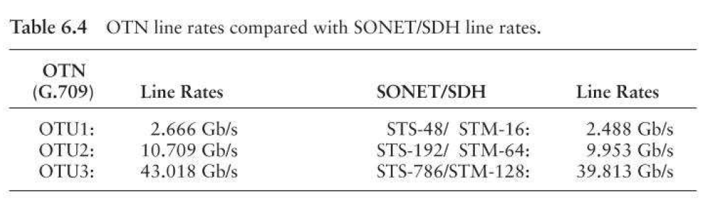
OTN line rates and key additional features
Forward error correction: 7% higher line rate
Management: OTN allows up to 6 tandem connections monitoring
Protocol Transparency: all types of packet traffic (10GEthernet, IP) and SONET/SDH frames
Asynchronous timing:
OTN payload floats within the frame to account for client clock mismatch

Slide 34
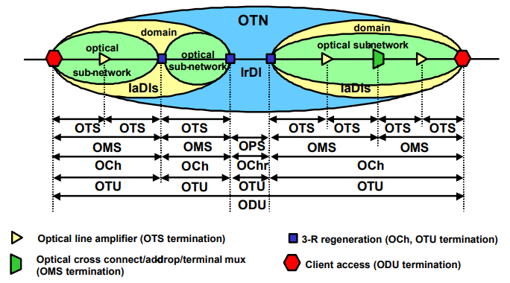
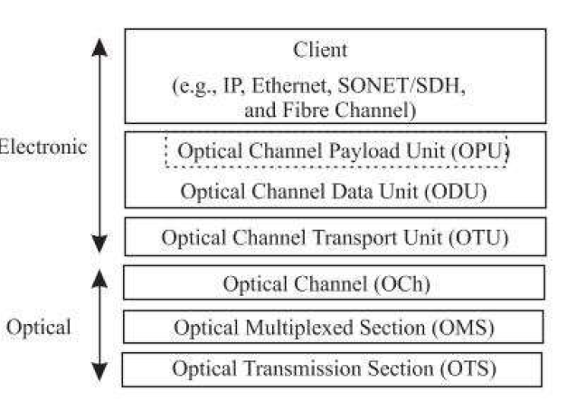
OTN hierarchy

Slide 35
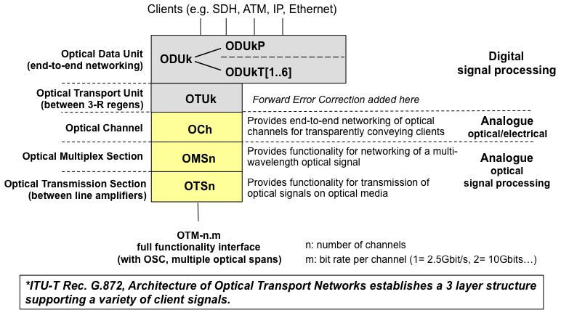
OTN Network Layers OTH Interface Structure

Slide 36
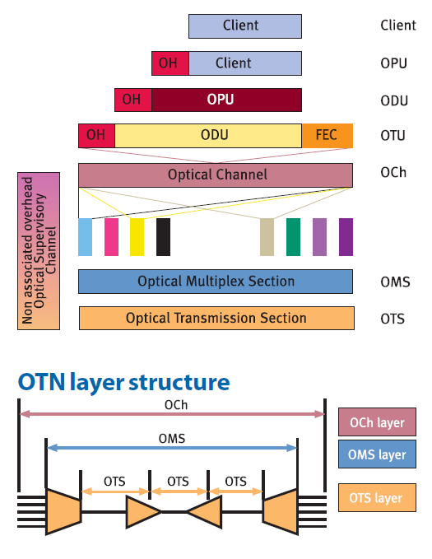
The Optical Transport Module

Slide 37
Optical Channel Data Unit (ODU)
The ODU is the single channel end-to-end network entity of the Optical Transport Network OTN
The ODU is terminated at the border of the OTN
The ODU consists of Optical Channel Payload Unit OPU and the ODU overhead for supervision & management
Trace for connectivity supervision (Path monitoring)
Support of nested tandem connection monitoring
Automatic Protection switching (APS) to protect against circuit failures. When a circuit or router fails, a backup immediately takes over.
Data communication channels (DCC) to access network devices for management access

Slide 38
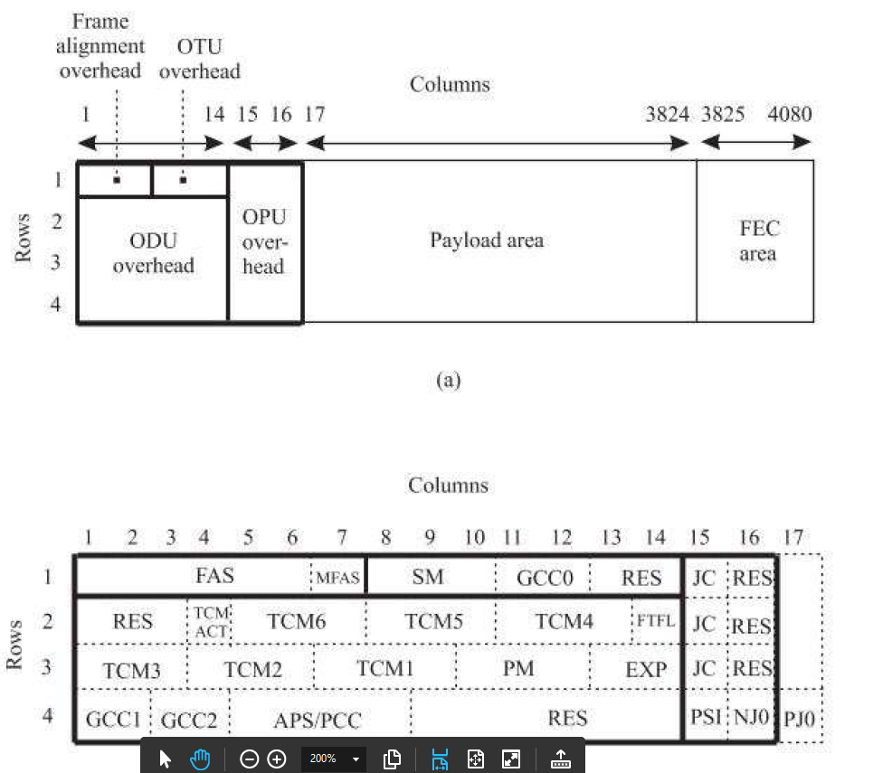
Optical Channel Data Unit (ODU) Frame Format
Frame format identical for all bit rates
The frame time depends on the bit-rate

Slide 39
Optical Channel Data Unit (ODU) Performance Monitoring/Tandem Connection Monitoring (PM/TCM)
Border of the OTN
Client mapping into ODU
Operator A
User
Operator B
Operator A
Working
User
Protection
Start of the OTN
Client mapping into ODU
protection supervision (TCM4)
domain and domain interconnect supervision (TCM3)
lead operator QoS supervision (TCM2)
user QoS supervision (TCM1)
end-to-end path supervision (PM)

Slide 40
End of session 8
Any questions?

